Slide 1
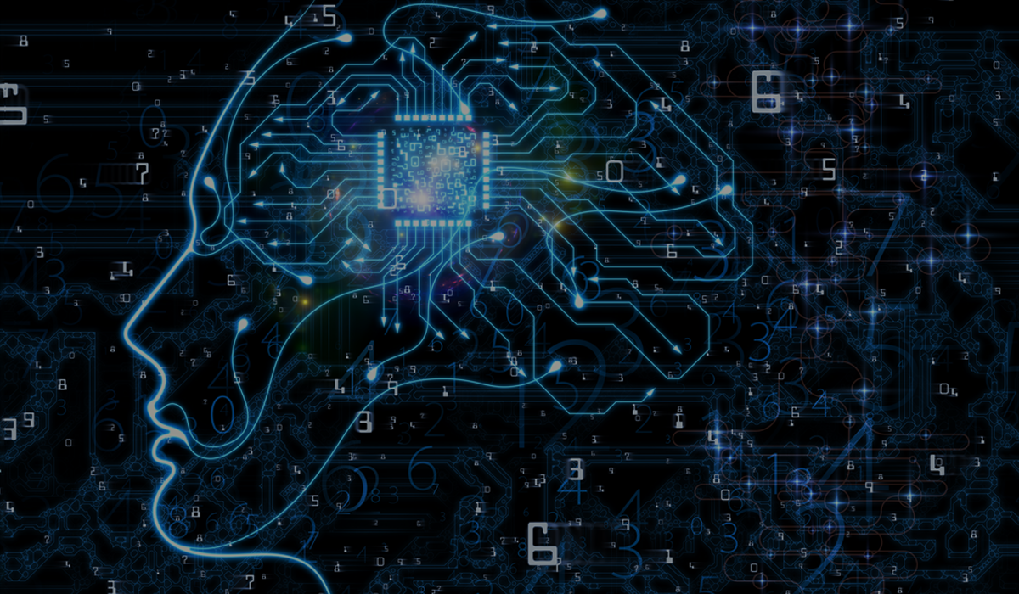
Classification of Alzheimer Disease stages in MRI Modality using Transfer learning
Batoul Khalil

Slide 2
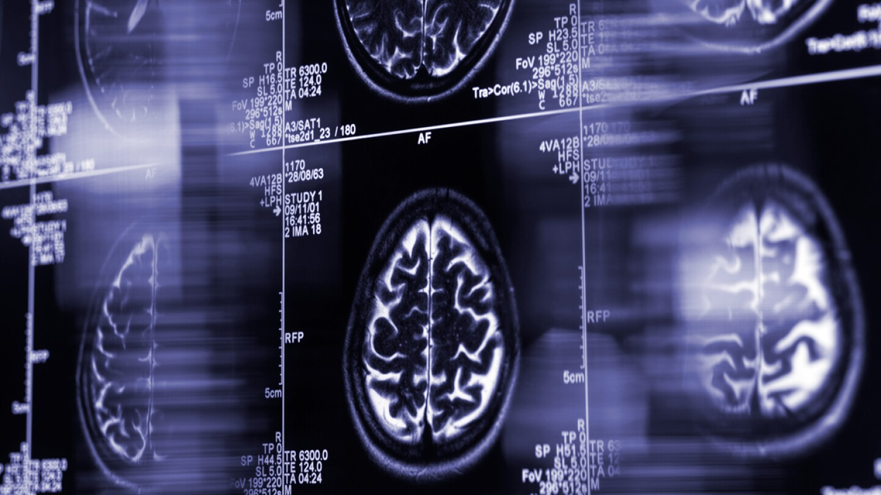
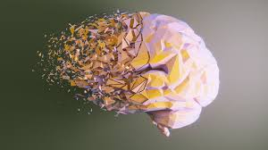
Introduction
Alzheimer’s disease (AD) is the most common type of dementia
Globally, more than 50 million people are estimated to be living with Alzheimer’s disease
MRI allows for the visualization of brain structure and the detection of structural changes that may occur in AD

Slide 3
assess the effectiveness of prominent computer vision algorithms in the context of Alzheimer’s stages detection, utilizing a moderately-sized academic dataset focused on neuroimaging. our objective is to conduct a comparative analysis of diverse models’ performance specifically within the realm of Alzheimer’s disease detection.
Objective :

Slide 4
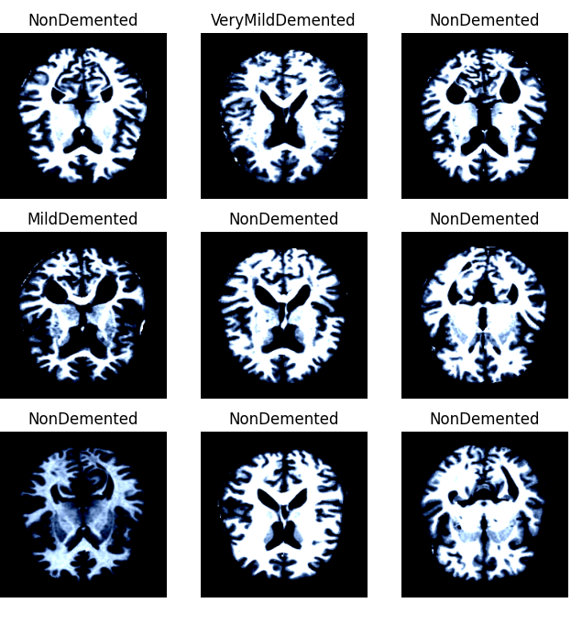
Dataset exploration and description:
Source : Kaggle
Two subdirectories : Train _Test
Number of images : 6400
MRI images categories: Non-Dementia, Very- Mild Dementia, Mild Dementia, and Moderate Dementia.
Images sizes: 256 by 256 pixels,

Slide 5
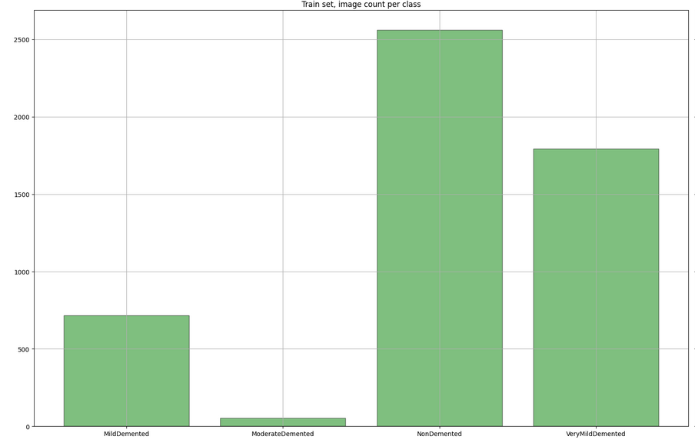
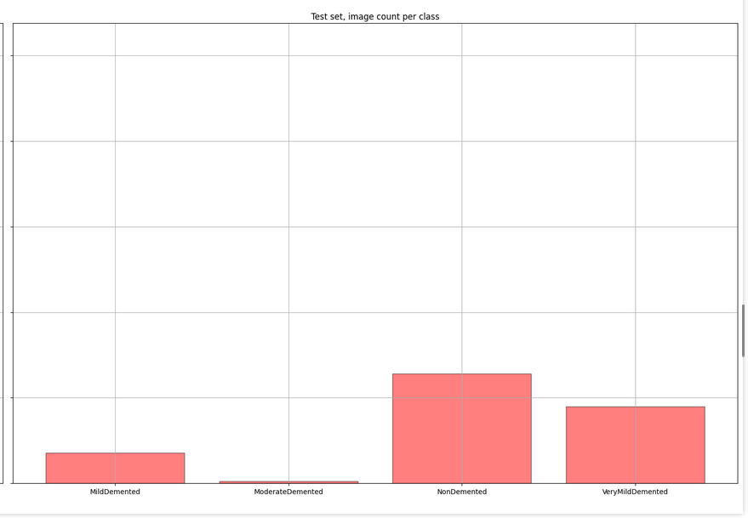
Data Exploration
Train _set
Test_set
Distribution of the images in both train ,test
5

Slide 6
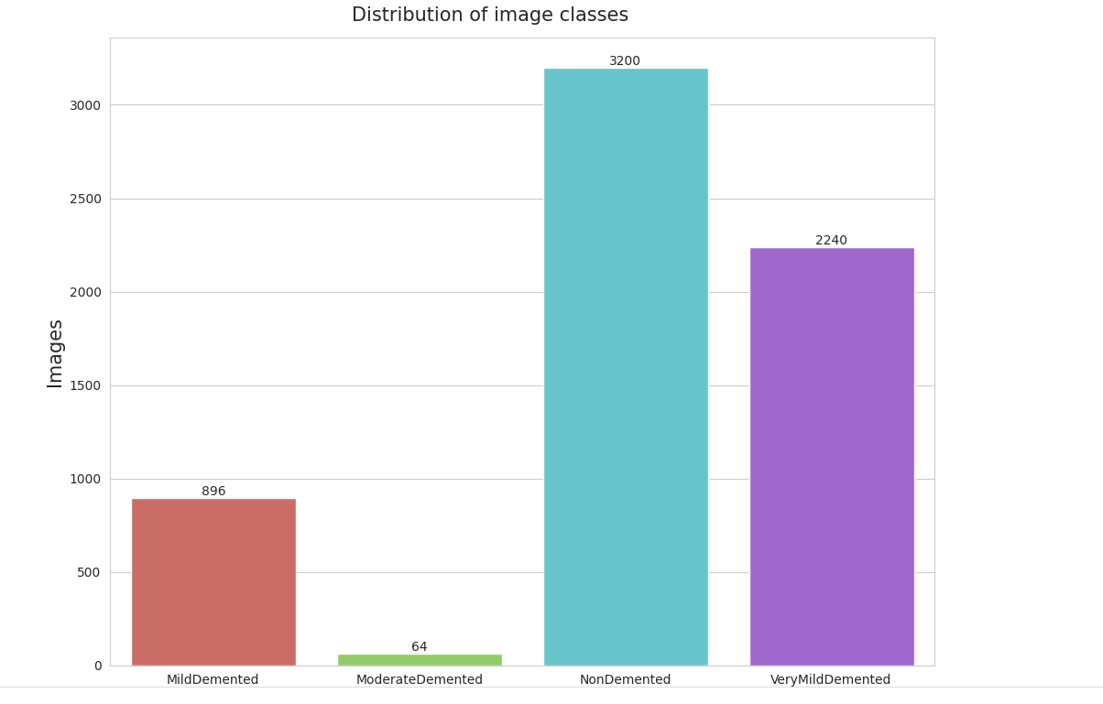
Data Exploration
Distribution after merging the two sets
6

Slide 7
Data Set Preprocessing for Deep Learning
Preprocessing transformation:
Preprocessing transformation for data augmentations
Resizing the images
Transforming the image into a tensor.
Adjusting the channels
Resize the images
Horizontally flip the image (50% chance).
Randomly rotate
Adjust the brightness and contrast, and the saturation
Transform the image into tensor.
Adjust the channels
7

Slide 8
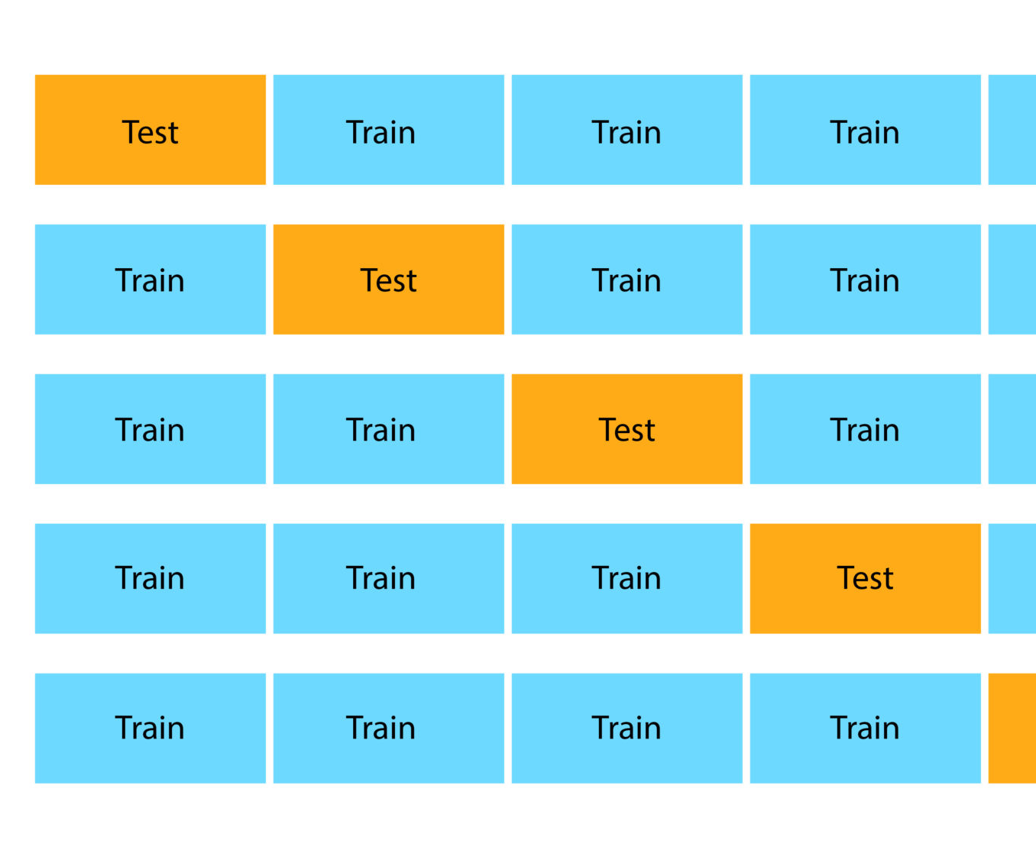
Cross validation
evaluate the performance of a model on unseen data
ensure that the model selected for deployment is robust and generalizes well to new data
prevent overfitting

Slide 9
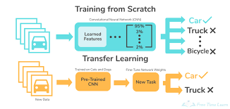
Transfer learning:
Saving training time
Better performance of neural networks
Doesn’t require big datasets

Slide 10
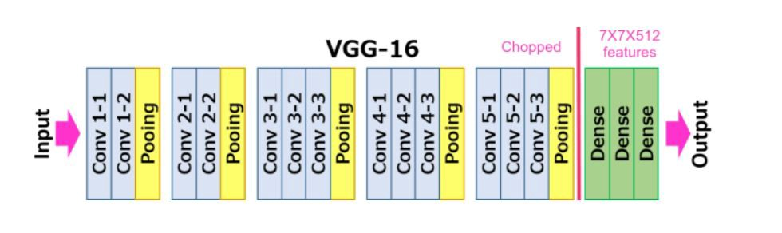
Vgg16
VGG16 is a CCN architecture introduced by the Visual Geometry Group (VGG) at the University of Oxford in 2014 .
Consists of 16 weight layers, comprising 13 conventional and fully connected layers.
138 million trainable parameters.
Input image size (224,224)

Slide 11
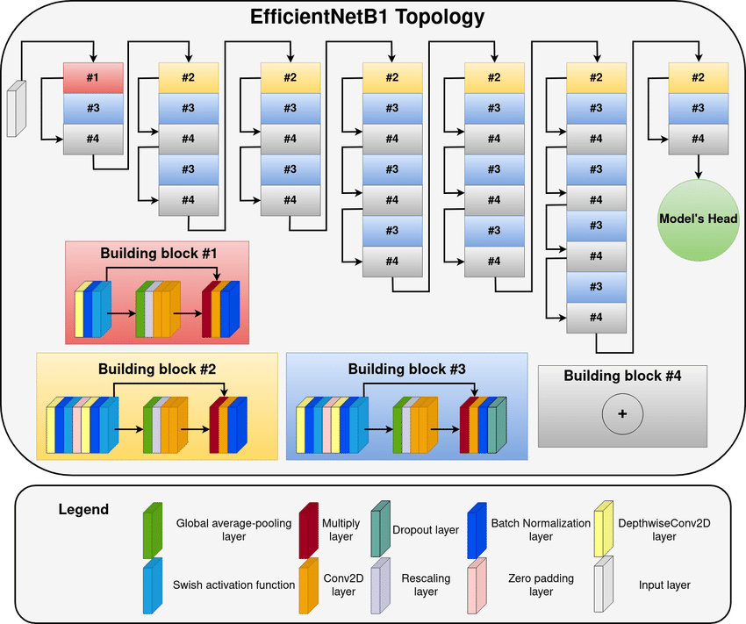
EfficientNetB1
powerful convolution neural network (CNN), introduced by Google AI in 2019
introduces compound scaling method that uniformly scales width, depth, and mage resolution with fixed coefficients
7.8M parameters.
Input image size (240,240)

Slide 12
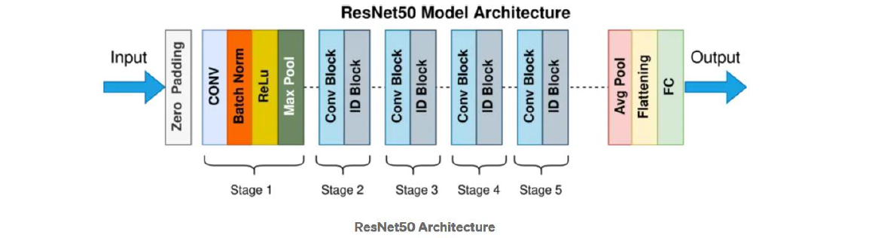
ReSNET50
(CNN) architecture that was developed by Microsoft Research in 2015.
The “50” in the name refers to the number of layers in the network, which is 50 layers deep
Overcoming the vanishing gradients problem
Parameters over 23M
Image size 224*224

Slide 13
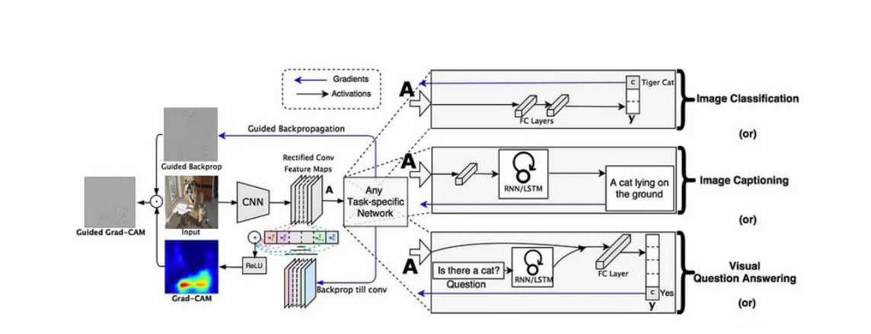
Grad cam
Grad-CAM (Gradient -weighted Class Activation Mapping)
Addresses the challenge of interpretability
highlighting the important regions
provides insights into model predications, helping to debug, improve performance

Slide 14

Results & Discussion: .

Slide 15
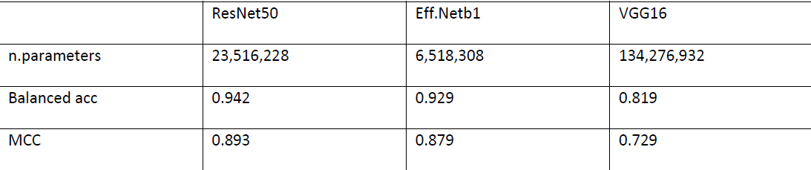
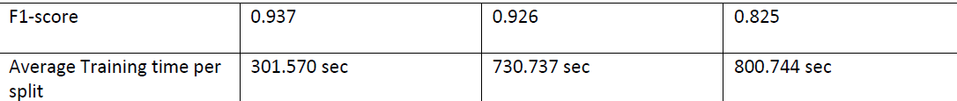
Cross-validation results of training the models

Slide 16
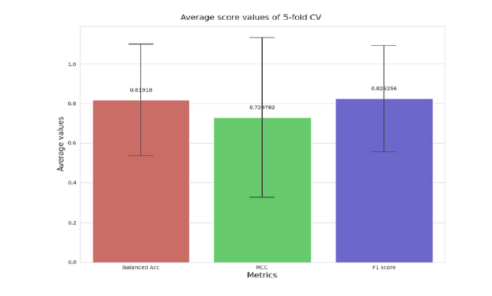
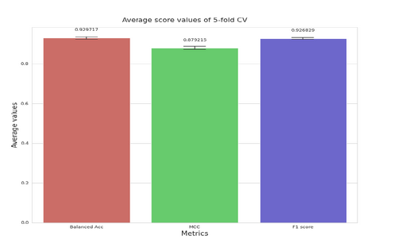
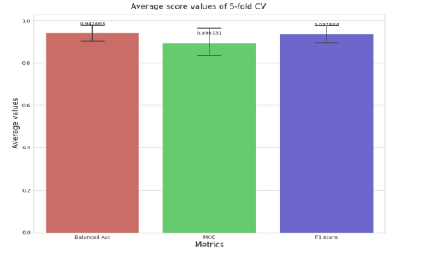
Cross validation average scores
EfficientNetB1
ResNet50
VGG16

Slide 17
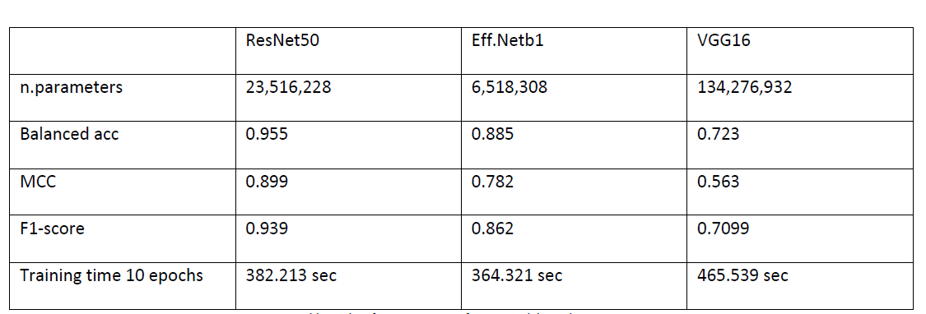
Models’ average scores in final model

Slide 18
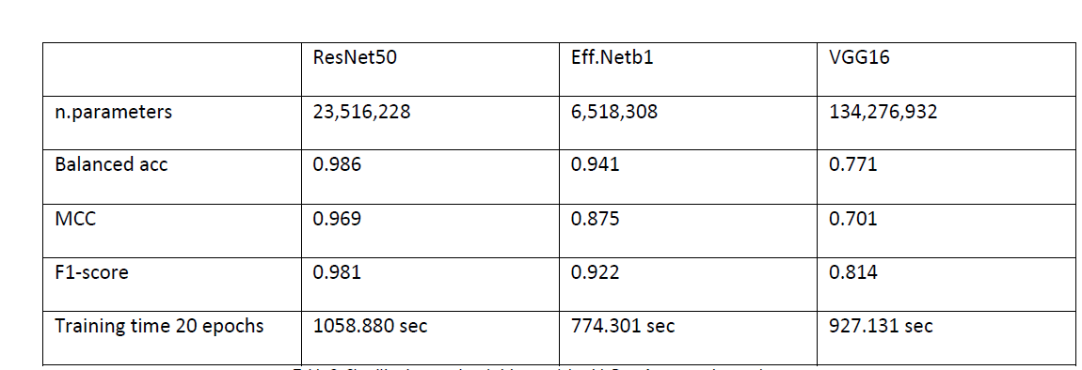
Models’ average scores using augmentation

Slide 19
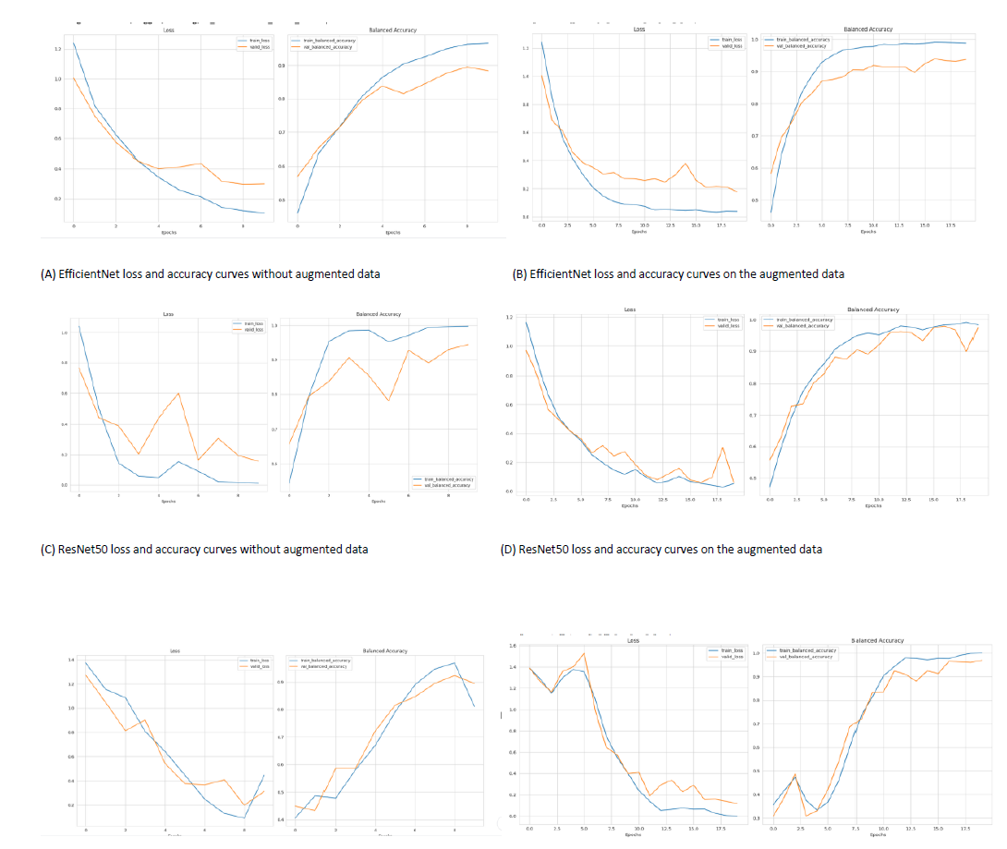
Models’ curves comparison with and without augmented data

Slide 20
Observation :
ResNet50 outperformed Vgg16 and EfficientNetb1
We noticed performance improvement after using augmentation

Slide 21
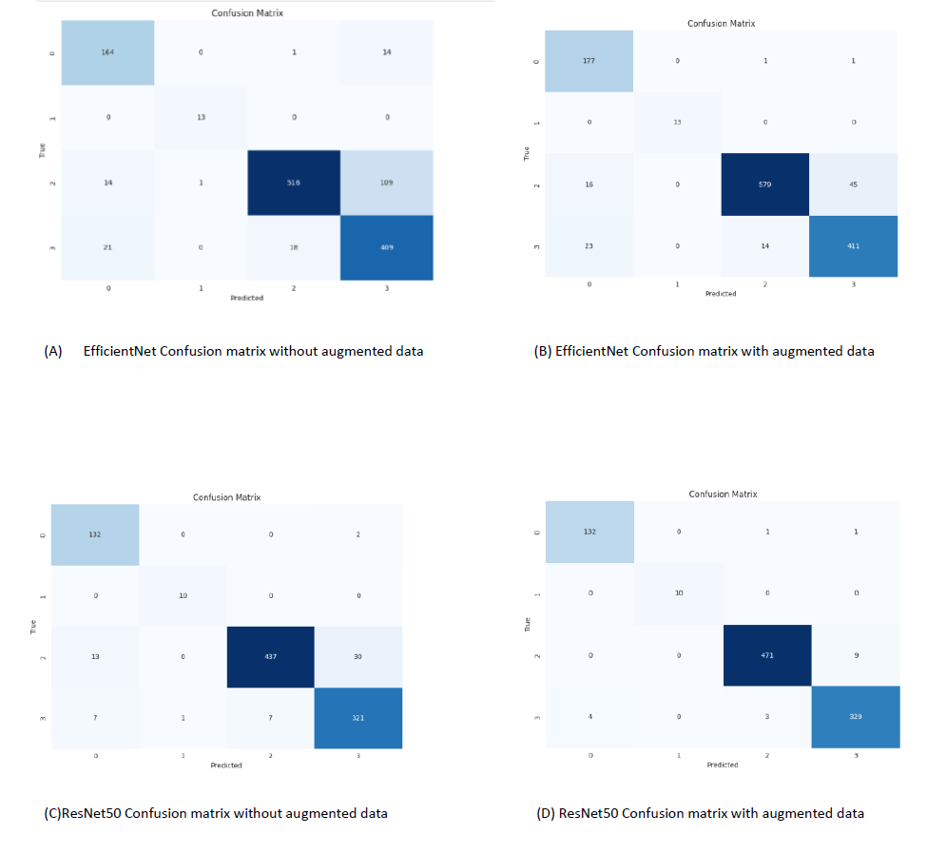
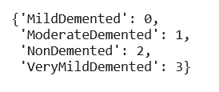
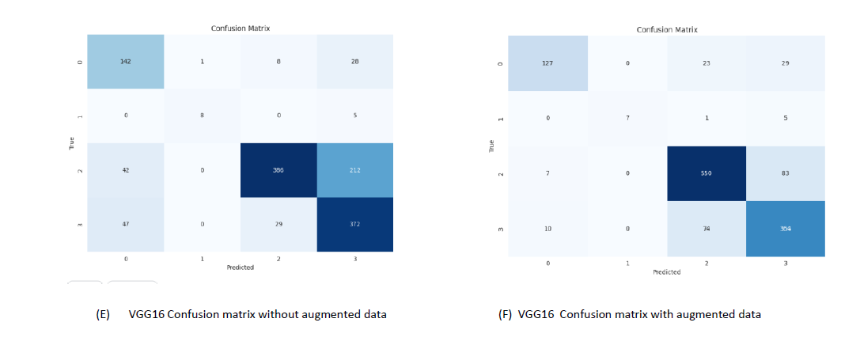
Models’ confusion matrices comparison with and without augmentation.

Slide 22
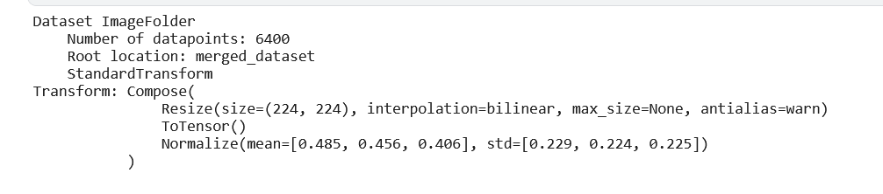
Stages of works
Preprocessing
Preprocessing (ImageFolder ,)
Building the model
Downloading the pretrained model and its weights.
Training
Cross validation
Final model
Testing
Unseen data
Augmentation
Using augmentation
Dataloser

Slide 23
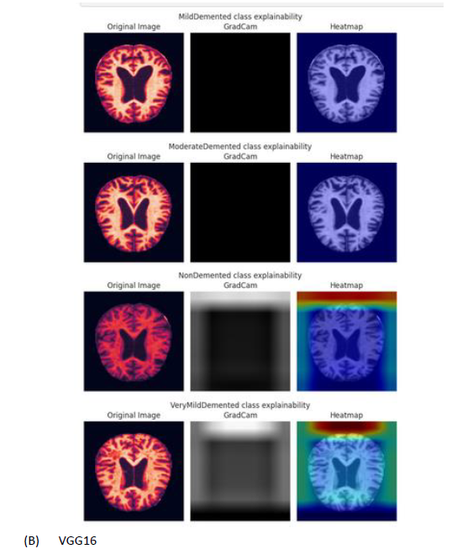
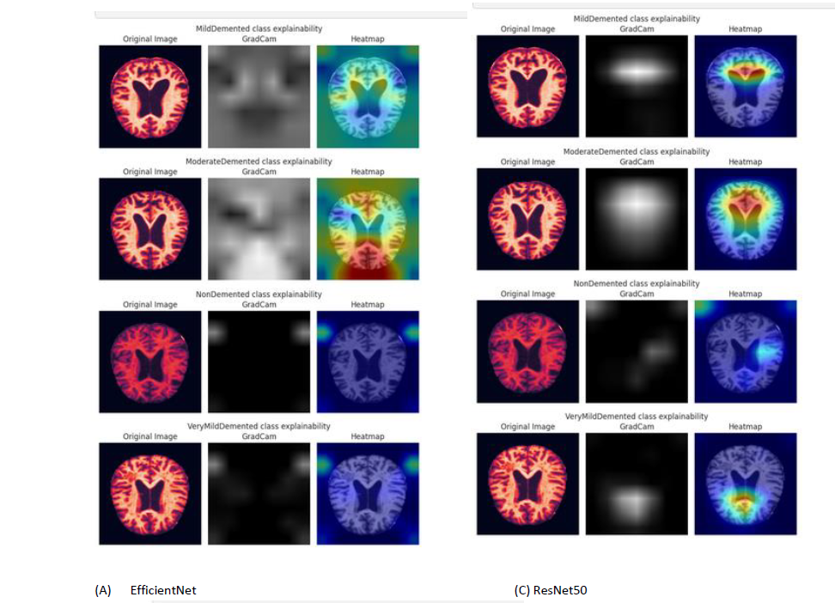
Grad cam results :

Slide 24
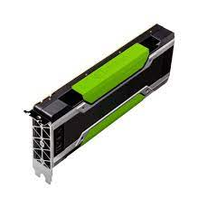


Project Details
Framework:
Processer
Platform
Pytorch
PyTorch is a machine learning framework based on the Torch library, used for applications such as computer vision and natural language processing,
GPU P100
The P100 graphics processor is built on a 16nm process featuring Pascal architecture
Kaggle

Slide 25
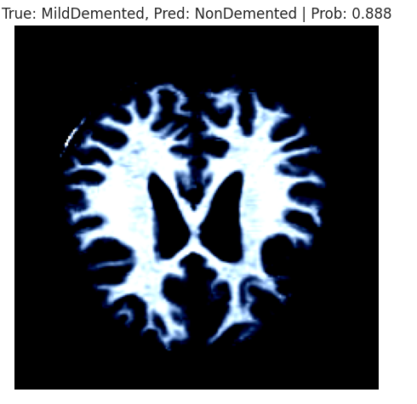
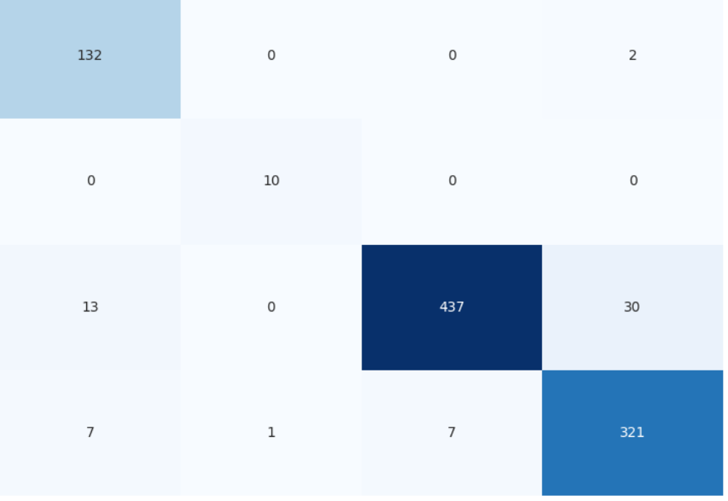
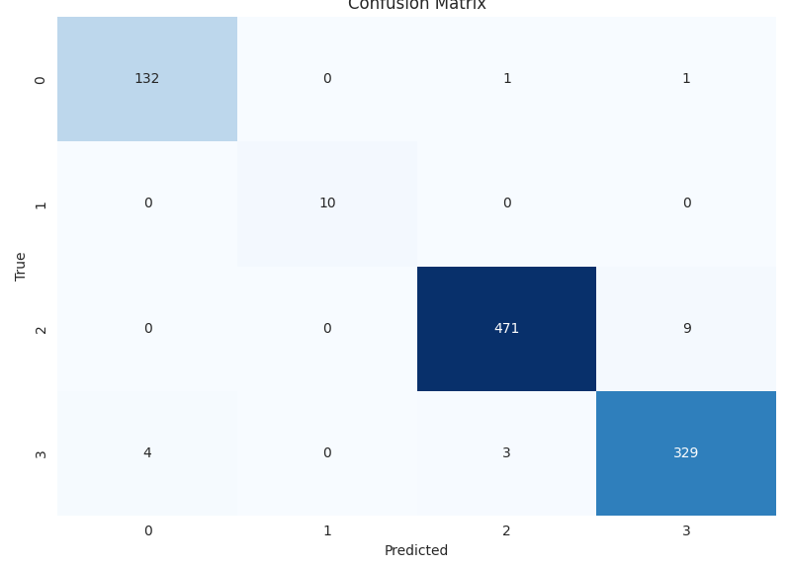
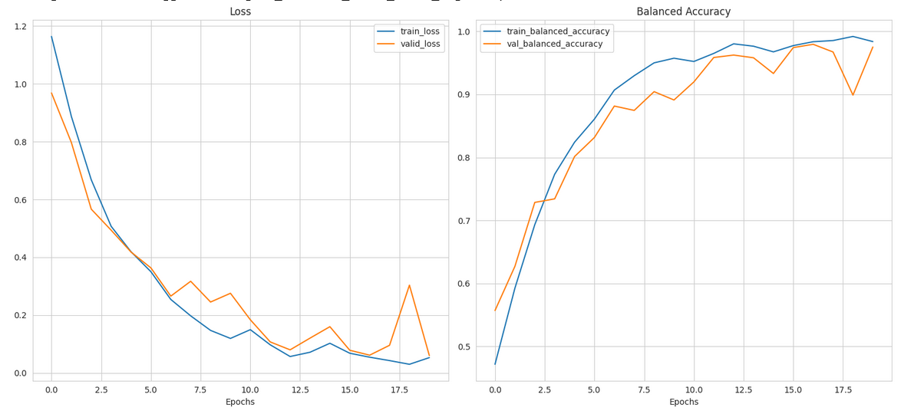
Summary
ResNet50 demonstrated superior performance compared to VGG16 and EfficientNet, achieving higher scores in the evaluation.
The application of augmentation techniques proved beneficial in enhancing the overall performance of all three models.
The models exhibited challenges in accurately classifying instances belonging to the Non-Demented and VeryMild-Demented categories
Employing Grad-Cam analysis provided insights into the factors contributing to ResNet's excellence and VGG's comparatively lower performance, thereby offering a comprehensive understanding of the models' classification capabilities.

Slide 26
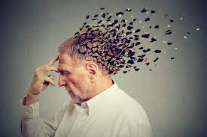
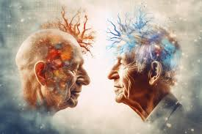
Thank you
Batoul khalil

